Slide 1
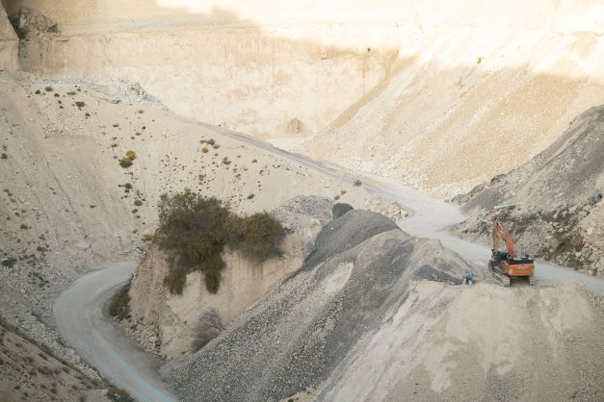
ENV 501 / GR A3 30 Exercise session 3: Handwritten MFA +
Jupyter Notebook MFA
Teaching assistant:
Jair Campfens jair.campfens@epfl.ch
Fall 2024

Slide 2
Exercise — Photovoltaic cell production
The production of photovoltaic cells can be represented in a simplified manner depicting only the two main processes; silicon wafer production and photocell production. The flow data for each of the processes are as follows:
Wafer production (for 1kg silicon wafers)
Input
Silicon [kg] | 1
Energy [MJ] | 420
Output
Silicon wafers [kg] | 1
Photocell production (for 1m² photovoltaic cells)
Input
Energy [MJ] | 13.6
Glass [kg] | 10
Silicon wafers [kg] | 1.6
Output
Photovoltaic cells [m²] | 1
Perform a system analysis: establish the system diagram and derive the balance equations.
Develop the output equations considering each of the inputs, and calculate the amount of energy, silicon and glass needed to produce 1 m² of PV cells.

Slide 3
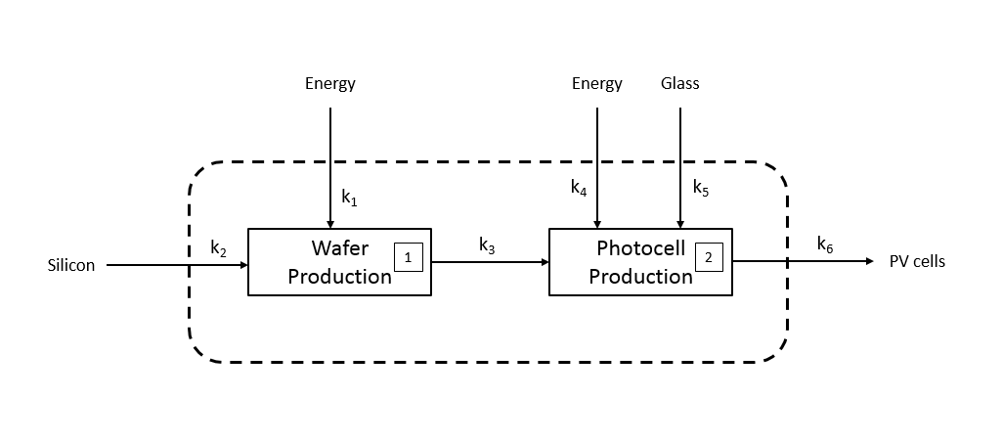
Exercise — Photovoltaic cell production

Slide 4
Exercise — Photovoltaic cell production
Input_{E1}∙k₁ + Input_{Si}∙k₂ = Output₁∙k₃
}
Input=
Output
Material or energy unit
k material and/or energy ratio

Slide 5
Exercise — Photovoltaic cell production
Input_{E1}∙k₁ + Input_{Si}∙k₂ = Output₁∙k₃
Output₁∙k₃ + Input_{E2}∙k₄ + Input_{G}∙k₅ = Output₂∙k₆
}
Input=
Output
Material or energy unit
k material and/or energy ratio

Slide 6
Exercise — Photovoltaic cell production
Input_{E1}∙k₁ + Input_{Si}∙k₂ = Output₁∙k₃
Output₁∙k₃ + Input_{E2}∙k₄ + Input_{G}∙k₅ = Output₂∙k₆
Input_{E1}∙k₁ + Input_{Si}∙k₂ + Input_{E2}∙k₄ + Input_{G}∙k₅ = Output₂∙k₆

Slide 7
Exercise — Photovoltaic cell production
The production of photovoltaic cells can be represented in a simplified manner depicting only the two main processes; silicon wafer production and photocell production. The flow data for each of the processes are as follows:
Wafer production (for 1kg silicon wafers)
Input
Silicon [kg] | 1
Energy [MJ] | 420
Output
Silicon wafers [kg] | 1
Photocell production (for 1m² photovoltaic cells)
Input
Energy [MJ] | 13.6
Glass [kg] | 10
Silicon wafers [kg] | 1.6
Output
Photovoltaic cells [m²] | 1
Perform a system analysis: establish the system diagram and derive the balance equations.
Develop the output equations considering each of the inputs, and calculate the amount of energy, silicon and glass needed to produce 1 m² of PV cells.

Slide 8
Exercise — Photovoltaic cell production
x kg Si-wafers = k₂∙x kg Si + k₁∙x MJ energy
x kg Si-wafers = 1∙x kg Si + 420∙x MJ energy
y m² PV cells = k₃∙y Si-wafers + k₅∙y kg glass + k₄∙y MJ energy
y m² PV cells = 1.6∙y Si-wafers + 10∙y kg glass + 13.6∙y MJ energy

Slide 9
Exercise — Photovoltaic cell production
Therefore, to produce 1 m² of PV cells, we need 1.6∙1 kg Si, 10∙1 kg glass, and (420∙1.6 + 13.6∙1) MJ energy.
→ 1.6 kg Si, 10 kg glass, and 685.6 MJ energy is required.

